Slide 1
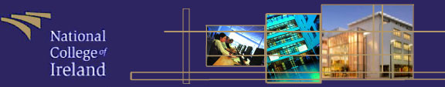
Lecture 1 – Brief History of Computers Dr. Paul Hayes

Slide 2
Computer Architecture
Civilization advances by extending
the number of important operations
which we can perform without
thinking about them.
Alfred North Whitehead 1911

Slide 3
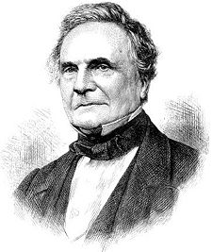
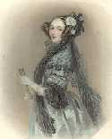
Computer Architecture
Charles Babbage: Analytical Engine (1834)
The design of a mechanical general-purpose computer
http://www.cbi.umn.edu/about/babbage.html

Slide 4
Computer Architecture
The Entscheidungsproblem
The Entscheidungs problem asks for an algorithm that will take as input a description of a formal language and a mathematical statement in the language and produce as output either "True" or "False" according to whether the statement is true or false.

Slide 5
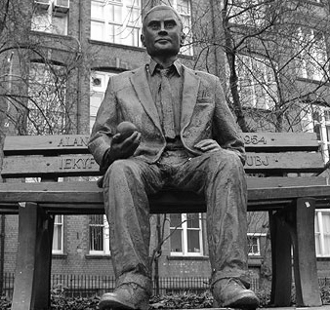
Computer Architecture
Turing Machine:
Turing machines are basic abstract symbol-manipulating devices which, despite their simplicity, can be adapted to simulate the logic of any computer algorithm.
They were described by Alan Turing in 1936.
It is a set of steps which can be repeated to
get a result – relevance to computers?

Slide 6
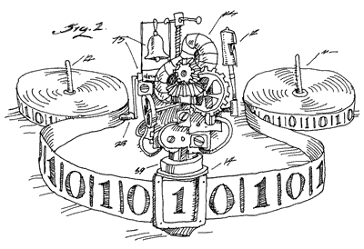
Computer Architecture
Turing machine

Slide 7
Computer Architecture
With Turing machines you have a tape Head to view an input symbol, an input tape, a finite table (instruction set) and a state register.
So if we wanted to use a Turing machine to ensure that the system could recognise all input words for an alphabet L we simply read the input symbols one at a time and follow the instruction set.
Graphically we can use Finite State Machines.

Slide 8
Computer Architecture
Finite State Machines:
All state machines consist of a number of states with input symbols connecting states to represent all the words in a given language.
A language is comprised of letters, letters joined together form words.
Each state is drawn using a circle with a name inside the circle, e.g. s0 (state zero).
s0

Slide 9
Computer Architecture
We move to another state after accepting a letter from a given alphabet (only a single letter can be accepted on a given transition). Example, if we have the alphabet L={a}, then the following would represent a suitable transition.
The above example says that if you are in s0 and you accept an “a” you move to s1.
s0
a
s1

Slide 10
Computer Architecture
Terminating States:
We represent terminating states using an extra inner circle within a state, example,
The above example says that if you are in s0 and you accept an “a” you move to s1, where you can now finish.
s0
a
so
s1

Slide 11
Computer Architecture
Example: Create FSMs for accepting all the words in the following alphabets: L={a, ab} and L={aab, aba}
s0
a
so
b
so
s1
s2
s2
a
b
s0
a
s1
so
s4
b
s3
a

Slide 12
Computer Architecture
Question: Construct a Finite State Machine to recognise all the following words in the following language L = {b, aa, bba, ba, aababaa, aaba, bbaba}.
Solution:
Firstly, the alphabet only consists of the following letters, “a” and
“b”.
so
a
so
s1
s3
b
s0
a
b
a
s2

Slide 13
Computer Architecture
Around 1944
John Atanasoff (Iowa State College) and George Stibbitz (Bell labs) produced calculators.
Atanasoffs machine was very advanced, used binary arithmetic and capacitors for memory, which were periodically refreshed to keep the charge from leaking out.

Slide 14
Computer Architecture
The First-Generation Vacuum tubes (1945 - 1955)
The stimulus for the electronic computer was World War 2. The English built a machine called COLOSSUS (with Alan Turings help) to decipher messages encrypted using the German ENIGMA machine.
COLOSSUS remained a government secret for 30 years, hence no advancement of the design. It is regarded as the first digital computer.

Slide 15
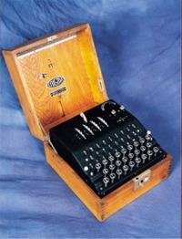
Computer Architecture
Enigma
The German military used the Enigma cipher machine during WW2 to keep their communications secret. The machine was available commercially during the 1920s, but the military potential of the device was quickly realised and the German army, navy and air force all used a more developed model of the machine to encipher their messages believing that it would make these communications impenetrable to the enemy.
The Enigma machine is an electro-mechanical device that relies on a series of rotating 'wheels' or ‘rotors’ to scramble plaintext messages into incoherent ciphertext. The machine's variable elements can be set in many billions of combinations, and each one will generate a completely different ciphertext message. If you know how the machine has been set up, you can type the ciphertext back in and it will unscramble the message. If you don't know the Enigma setting, the message remains indecipherable.
The German authorities believed in the absolute security of the Enigma. However, with the help of Polish mathematicians who had managed to acquire a machine prior to the outbreak of WW2, British code breakers stationed at Bletchley Park managed to exploit weaknesses in the machine and how it was used and were able to crack the Enigma code.
Breaking the Enigma ciphers gave the Allies a key advantage, which, according to historians, shortened the war by two years thus saving many lives.

Slide 16
Computer Architecture
ENIAC (Electronic Numerical Integrator and Computer):
John Mauchley and J. Presper Eckert developed an electronic computer with US military funding (1943 - 1946), called ENIAC.
The computer consisted of 18,000 vacuum tubes and 1500 relays. The ENIAC weighed 30 tons and consumed 140 kilowatts of power. Architecturally the machine had 20 registers, each capable of holding a 10-digit decimal number.
The ENIAC was programmed using 6000 multiposition switches connecting a multitude of sockets.

Slide 17
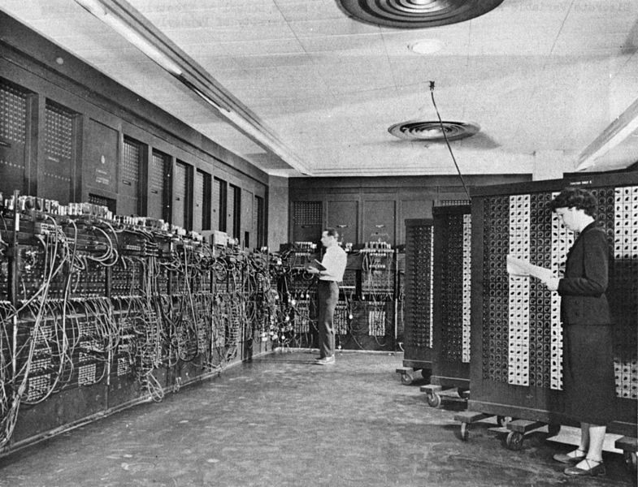
Computer Architecture

Slide 18
Computer Architecture
Since the machine wasn’t ready until the war had ended the ENIAC team held a summer school to show off their computer to fellow researchers. This started widespread development of similar machines.
ENIAC team tried to file for a Patent claiming they invented the digital computer but were turned down and Atanasoff was accredited (even though he didn’t seek a patent).
John von Neumann (also part of the ENIAC team) decided that programming computers with all the switches and cables was too slow and believed that the program could also be stored in digital form (Institute for Advanced Study or more commonly known as the IAS machine).

Slide 19
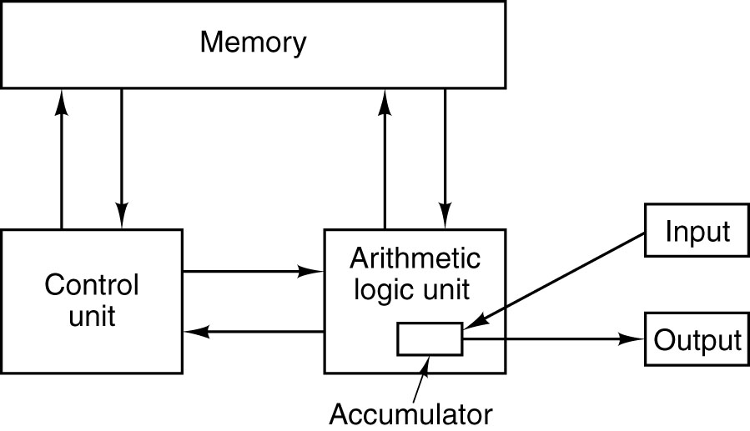
Computer Architecture
Von Neumann machine

Slide 20
Computer Architecture
Whirlwind 1
Around the same time as IAS (Von Neumann) researchers at M.I.T. were developing Whirlwind 1 which had only a 16-bit word and was designed for real-time control.
The project led to the invention of the magnetic core by Jay Forrester, and eventually to the first commercial minicomputer.
IBM was still only involved in generating punch cards and mechanical card sorting machines. IBM produced their first machine in 1953.

Slide 21
Computer Architecture
The Second Generation – Transistors (1955-1965):
The transistor was invented at Bell Labs by John Bardeen, Walter Brattain and William Shockley in 1948 which won the Nobel Prize in physics in 1956.
Within 10 years the transistor revolutionised computers and by the late 1950s, vacuum computers were obsolete.

Slide 22
Computer Architecture
The first transistor computer was built at Micro Instrumentation and Telemetry Systems (MITS) Lincoln Lab, a 16-bit machine along the lines of Whirlwind 1 called TX-0.
Kenneth Olsen (one of the engineers who worked on the TX-0 and TX-2) formed a company Digital Equipment Corporation (DEC) in 1957 to manufacture a commercial machine called the PDP-1 (released in 1961).
PDP-1(included a visual screen) was roughly half as powerful as the IBM machine at the time but only cost $120,000 in comparison to the Millions of dollars for the IBM machine.
A PDP-1 was given to M.I.T. where students produced the first computer game called “Spacewar”

Slide 23
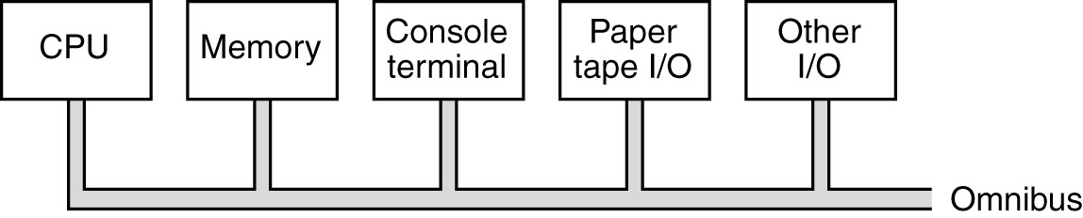
Computer Architecture
PDP-8
A few years later DEC introduced the PDP-8, which was a twelve bit machine, but much cheaper ($16,000).
The PDP-8 had a major innovation: a single bus, the omnibus. A bus is a collection of parallel wires used to connect the components of a computer (sold around 50,000 PDP-8).

Slide 24
Computer Architecture
IBM and Control Data Corporation (CDC) continued to make faster machines while DEC produced cheap machines.
In 1964 CDC had a major breakthrough with the 6600 model, a highly parallel machine capable of running 10 instructions at the same time. It had additional support for administrative functionality that resembled supercomputers.
The designers of the B5000 machine took a different approach and focused on building a machine that was orientated around software → the idea that software counted was born!

Slide 25
Computer Architecture
The Third Generation – Integrated Circuits (1965 - 1980):
The invention of the silicon integrated circuit by Robert Noyce in 1958 allowed dozens of transistors to be placed on a single chip. This meant smaller, faster and cheaper computers.
IBM now a major player in the market moved to a single line of production: the System/360. This system included multiprogramming which resulted in higher CPU utilization.
It was also the first system that could emulate earlier systems like the 1401 and the 7094.

Slide 26
Computer Architecture
The Fourth Generation
By the 1980s Very Large Scale Integration (VLSI) had made it possible to put first 1000s, then 100,000s, and finally 1,000,000s of transistors on a single chip. Prices dropped dramatically → personal computer industry started.
The first operating system became available on the Intel 8080 → file system and shell
Steve Jobs and Steve Wozniak produced Apple and later Apple II from their garage

Slide 27
Computer Architecture
IBM paid an executive a large amount of money to go off and build IBMs first personal computer.
He picked the Intel 8088 as his CPU and built it from commercial components.
Introduced in 1981 it instantly became the best selling computer of the time.
IBM published the design and the industry exploded.

Slide 28
Computer Architecture
Apple Lisa was the first computer to come with a Graphical User Interface (GUI) but failed to impress as it was too expensive
A year later in 1984 the Macintosh was born.
The first version of the IBM PC came equipped with MS-DOS operating system installed from the then tiny company Microsoft.

Slide 29
Computer Architecture
In 1985 the 386 was released (basically the first Pentium), all modern Pentiums are much faster but have the same kind of architecture.
Until 1992, PCs were either 8-bit, 16-bit or 32-bit however DEC released a 64-bit machine (took about 10 years before they became popular).

Slide 30
Computer Architecture
The Fifth Generation
Quantum computers?
qubits versus bits
http://www.howstuffworks.com/quantum-computer.htm
http://www.qubit.org/
http://www.nytimes.com/2010/11/09/science/09compute.html
Notes:
What is Quantum Physics?
Quantum physics is a branch of science that deals with discrete, indivisible units of energy called quanta as described by the Quantum Theory. There are five main ideas represented in Quantum Theory:
Energy is not continuous, but comes in small but discrete units. ¹
The elementary particles behave both like particles and like waves. ²
The movement of these particles is inherently random. ³
It is physically impossible to know both the position and the momentum of a particle at the same time. The more precisely one is known, the less precise the measurement of the other is.⁴
The atomic world is nothing like the world we live in. ⁵

Slide 31
Computer Architecture
The Fifth Generation
Integrated devices. The fifth generation is seen more as a paradigm shift as apposed to a specific new architecture.
The concept of pervasive or ubiquitous computing is seen as the fifth generation where everything will and probably should talk to everything else.

Slide 32
Computer Architecture
The Sixth Generation?
If we can call the ubiquitous computing a generation of computing then we can consider that cloud computing will probably be seen as the sixth generation or perhaps an enhancement of the fifth.
With cloud computing all you need is a dumb machine and a good connection to the internet. Protocols such software as a service and hardware as a service will change the face of computing for many organisations and home users.
Coupled with cloud computing the internet 2 project will give everything an ip address and increased internet speed.

Slide 33

Computer Architecture

Slide 34
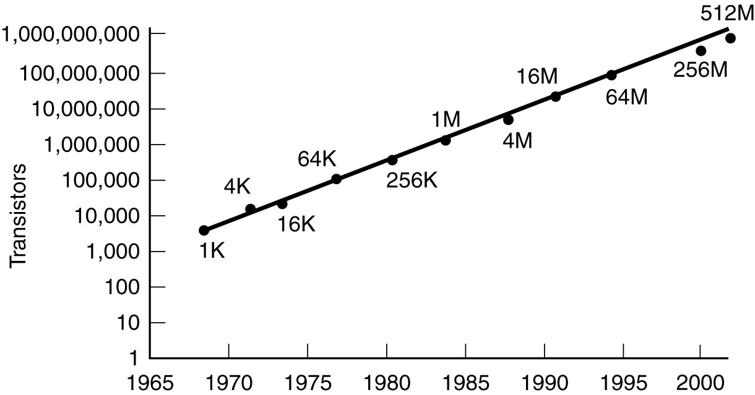
Computer Architecture
Moore’s Law:
Predicts a 60% annual increase in the number of transistors that can be put on a chip.
the year 2020 or 2030 will find the circuits on a microprocessor measured on an atomic scale.

Slide 35
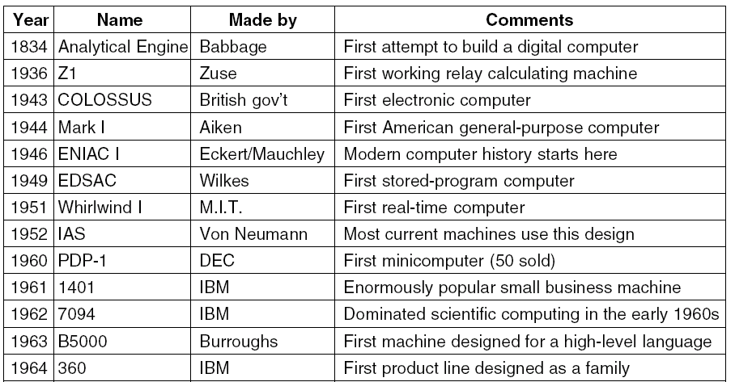
Computer Architecture

Slide 36
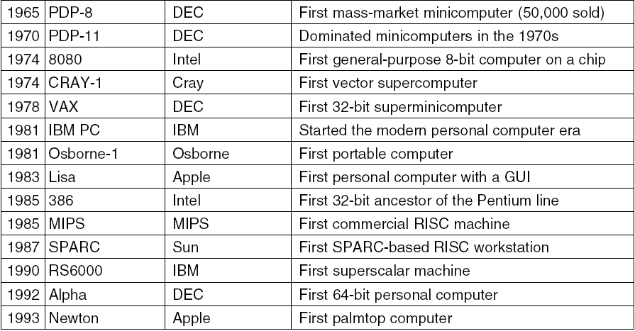
Computer Architecture

Slide 37
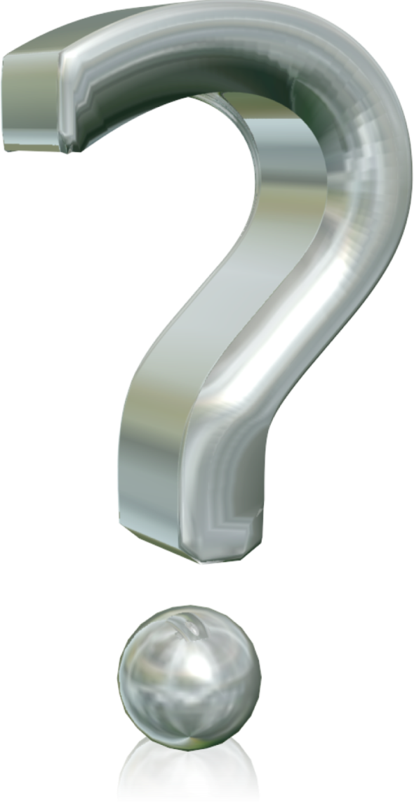
Computer Architecture
Phayes@ncirl.ie

